Slide 1
ChatBot Sprint 2 Demo
Picking a Local Model
Aaron Antreassian, Christopher Mata, and Eli Kulpinski

Slide 2
Sprint Contributions
Aaron:
Research and Evaluation on Different Local AI Models
Research on Langchain and How to Implement it with our Model
Setup Local Environment for AI Models to Run
Local AI Model Evaluation Meeting
Setup Demo Presentation
Research for Next Sprint and running Open LLM
Chris:
Research and Evaluation on Different Local AI Models
Research on Langchain and How to Implement it with our Model
Setup Local Environment for AI Models to Run
Local AI Model Evaluation Meeting
Moved Flowise to a general structure LangChain project (setting up the environment was a pain)
Eli:
Researched Machine Learning and Large Language Model (LLM) Evaluation Metrics.
Gathered publicly available LLMs and conducted individual comparisons.
Compared our top LLM choices.
Assisted in transitioning from LangFlow to LangChain.
Set up software and testing environments for running local models.
Conducted testing and evaluation of our top local model.
Researched dataset creation and fine-tuning strategies for our local model in preparation for the next two sprints.
Participated in multiple meetings related to the project.

Slide 3
Sprint 2 Objectives
●Transition from LangFlow to LangChain
●Finalize criteria for evaluating large language models
●Choose five local LLMs per member to evaluate
●Discuss our models results
●Evaluate each member's top model (top three)
●Compare and Implement the best model for our use case
●Add a vectorized database for information storing functionality

Slide 4
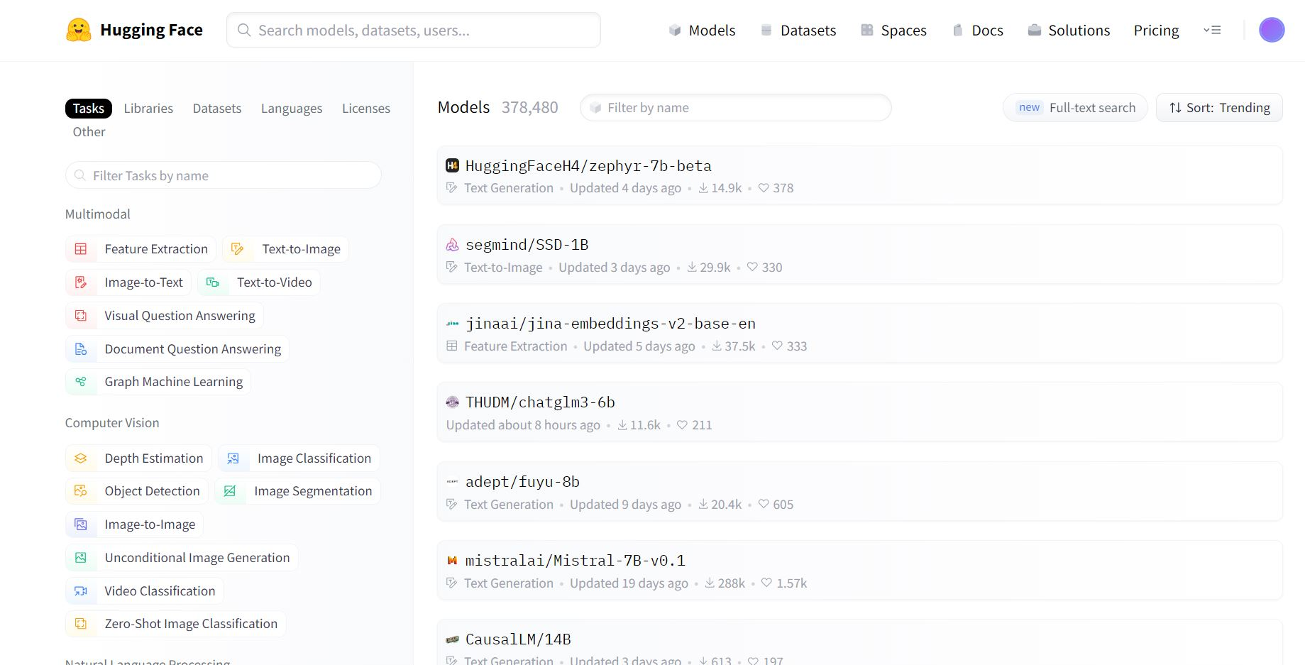

Slide 5
Evaluating Our AI Models
Machine Learning
Precision: The quality of a positive prediction made by the model.
Recall: The percentage of data samples that a machine learning model correctly identifies as belonging to a class of interest.
Accuracy (F1 Score): How many times a model made a correct prediction across the entire dataset.
Natural Language Processing
Perplexity: A measurement of how well a probability model predicts a sample (dataset).
Helps us understand how well the model has learned the patterns of language.
HuggingFace LLM Leaderboard
Allows us to quickly evaluate open source LLMs with up-to-date metrics.

Slide 6
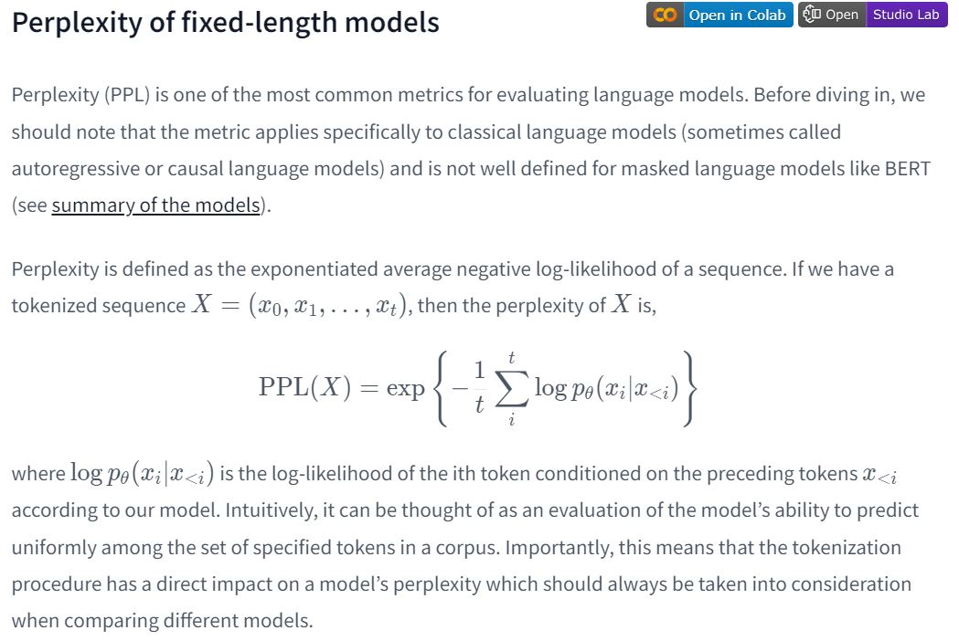

Slide 7
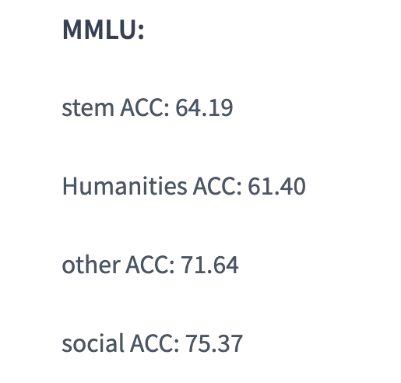
Aaron LLM Models
My top two models were llama-2 and Causallm
Causallm only has self reported data

Slide 8
Chris LLM Models
These are my top 2 models
Mistral/Open-orca won by a large margin

Slide 9
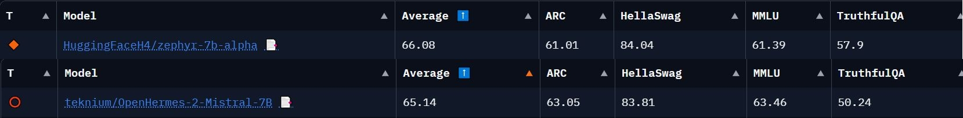
Eli LLM Models

Slide 10
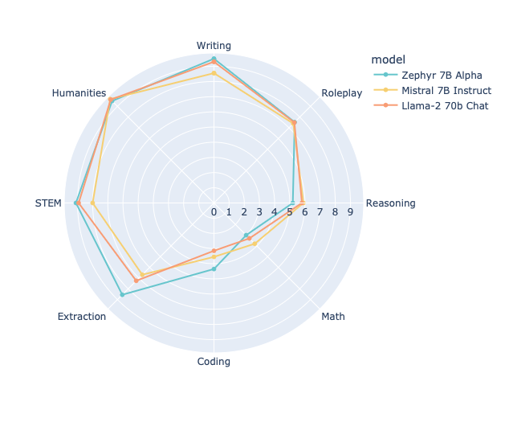

Slide 11
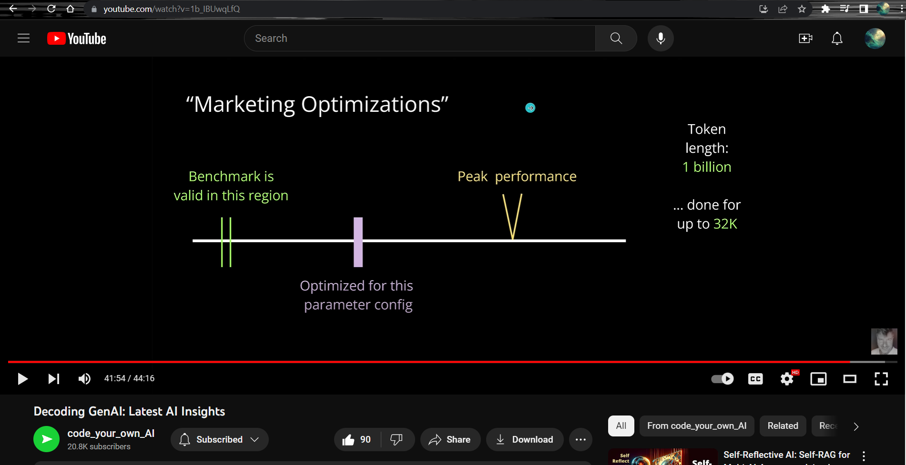

Slide 12
Model Results: Mistral-Open-Orca-7b
Zephyr-7b-alpha has the highest Average and TruthfulQA values
After custom prompt testing Zephyr-7b-alpha vs Mistral-Open-Orca vs Llama-2-7b-hf, Mistral-Open-Orca was the winner.
Zephyr performs well but doesn’t listen to rules/guidelines as much which negates its benefits in other forms of intelligence.
Mistral-Open-Orca balances following the users prompt while answering accurately in both content and instructions the best, out of the three models, and as such is best suited for our projects needs.
Further testing possible to compare Mistral-Open-Orca vs Mistral-Open-Hermes although negligible differences noticed at this time.
Note: Mistral-Open-Orca-7b has an Apache-2.0 License, fitting our use case.

Slide 13
Project Improvements From Local Model
By utilizing Mistral-Open-Orca-7b as our local model, our project enjoys the following benefits:
Enhanced Privacy and Data Control
Decreased Latency
Improved Cost Efficiency
Enhanced Customization
Reduced Reliance on Third-Party Services
Heightened Security Capacity
Lower Bandwidth Consumption
Increased Scalability Options
Diminished Susceptibility to Service Disruptions

Slide 14
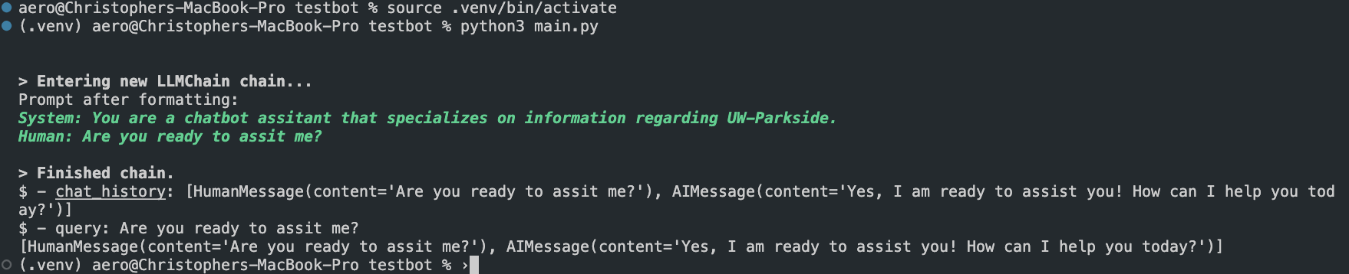
LangChain Demo

Slide 15
Sprint 3: Preparing Our Model For Fine-Tuning
Meet with Matt McPherson about Deployment Server (chat.cs.uwp.edu)
Clone Parkside and Related Websites
Convert Relevant Webpage Contents (HTML to TXT)
Clean Website Contents (TXT File)
Format the Website Contents Dataset as Prompt-Response
Compare and Decide Fine-Tuning Method (PPO, DPO, LORA, QLORA, LOFTQ, AWQ, GPTQ, NEFT, Etc)
Model Evaluation Before Fine-Tuning (For Comparison Post Fine-Tuning)
Deploy Dataset into Vectorized Database
Security Testing for Model Before Fine-Tuning

